Slide 1
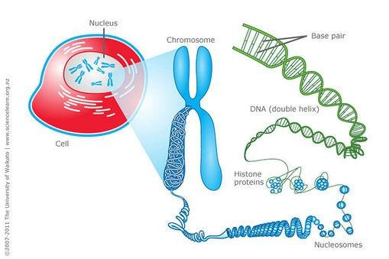
GPB111 FUNDAMENTALS OF GENETICS

Slide 2
LECTURE 1. DEFINITION OF GENETICS, HEREDITY,
INHERITANCE, CYTOLOGY, CYTOGENETICS; BRIEF HISTORY OF DEVELOPMENTS IN GENETICS AND CYTOGENETICS.

Slide 3
Genetics
Genetics is a biological science, which deals with principles of heredity
and variation.
Heredity - process which brings about the biological similarity between parents and progeny.
Deals with inheritance of characters from parents to offsprings.
Inheritance is the transmission of – genetic information from parents and ancestors to offspring.
All characters are governed by genes
Genetics is the study of
» structure
» Behaviour
» composition
» function of genes

Slide 4
Variation: The differences among individuals of a single species for a particular character.
Genes: are the functional units that govern the development of characters of an individual.
Gene - unit of inheritance

Slide 5
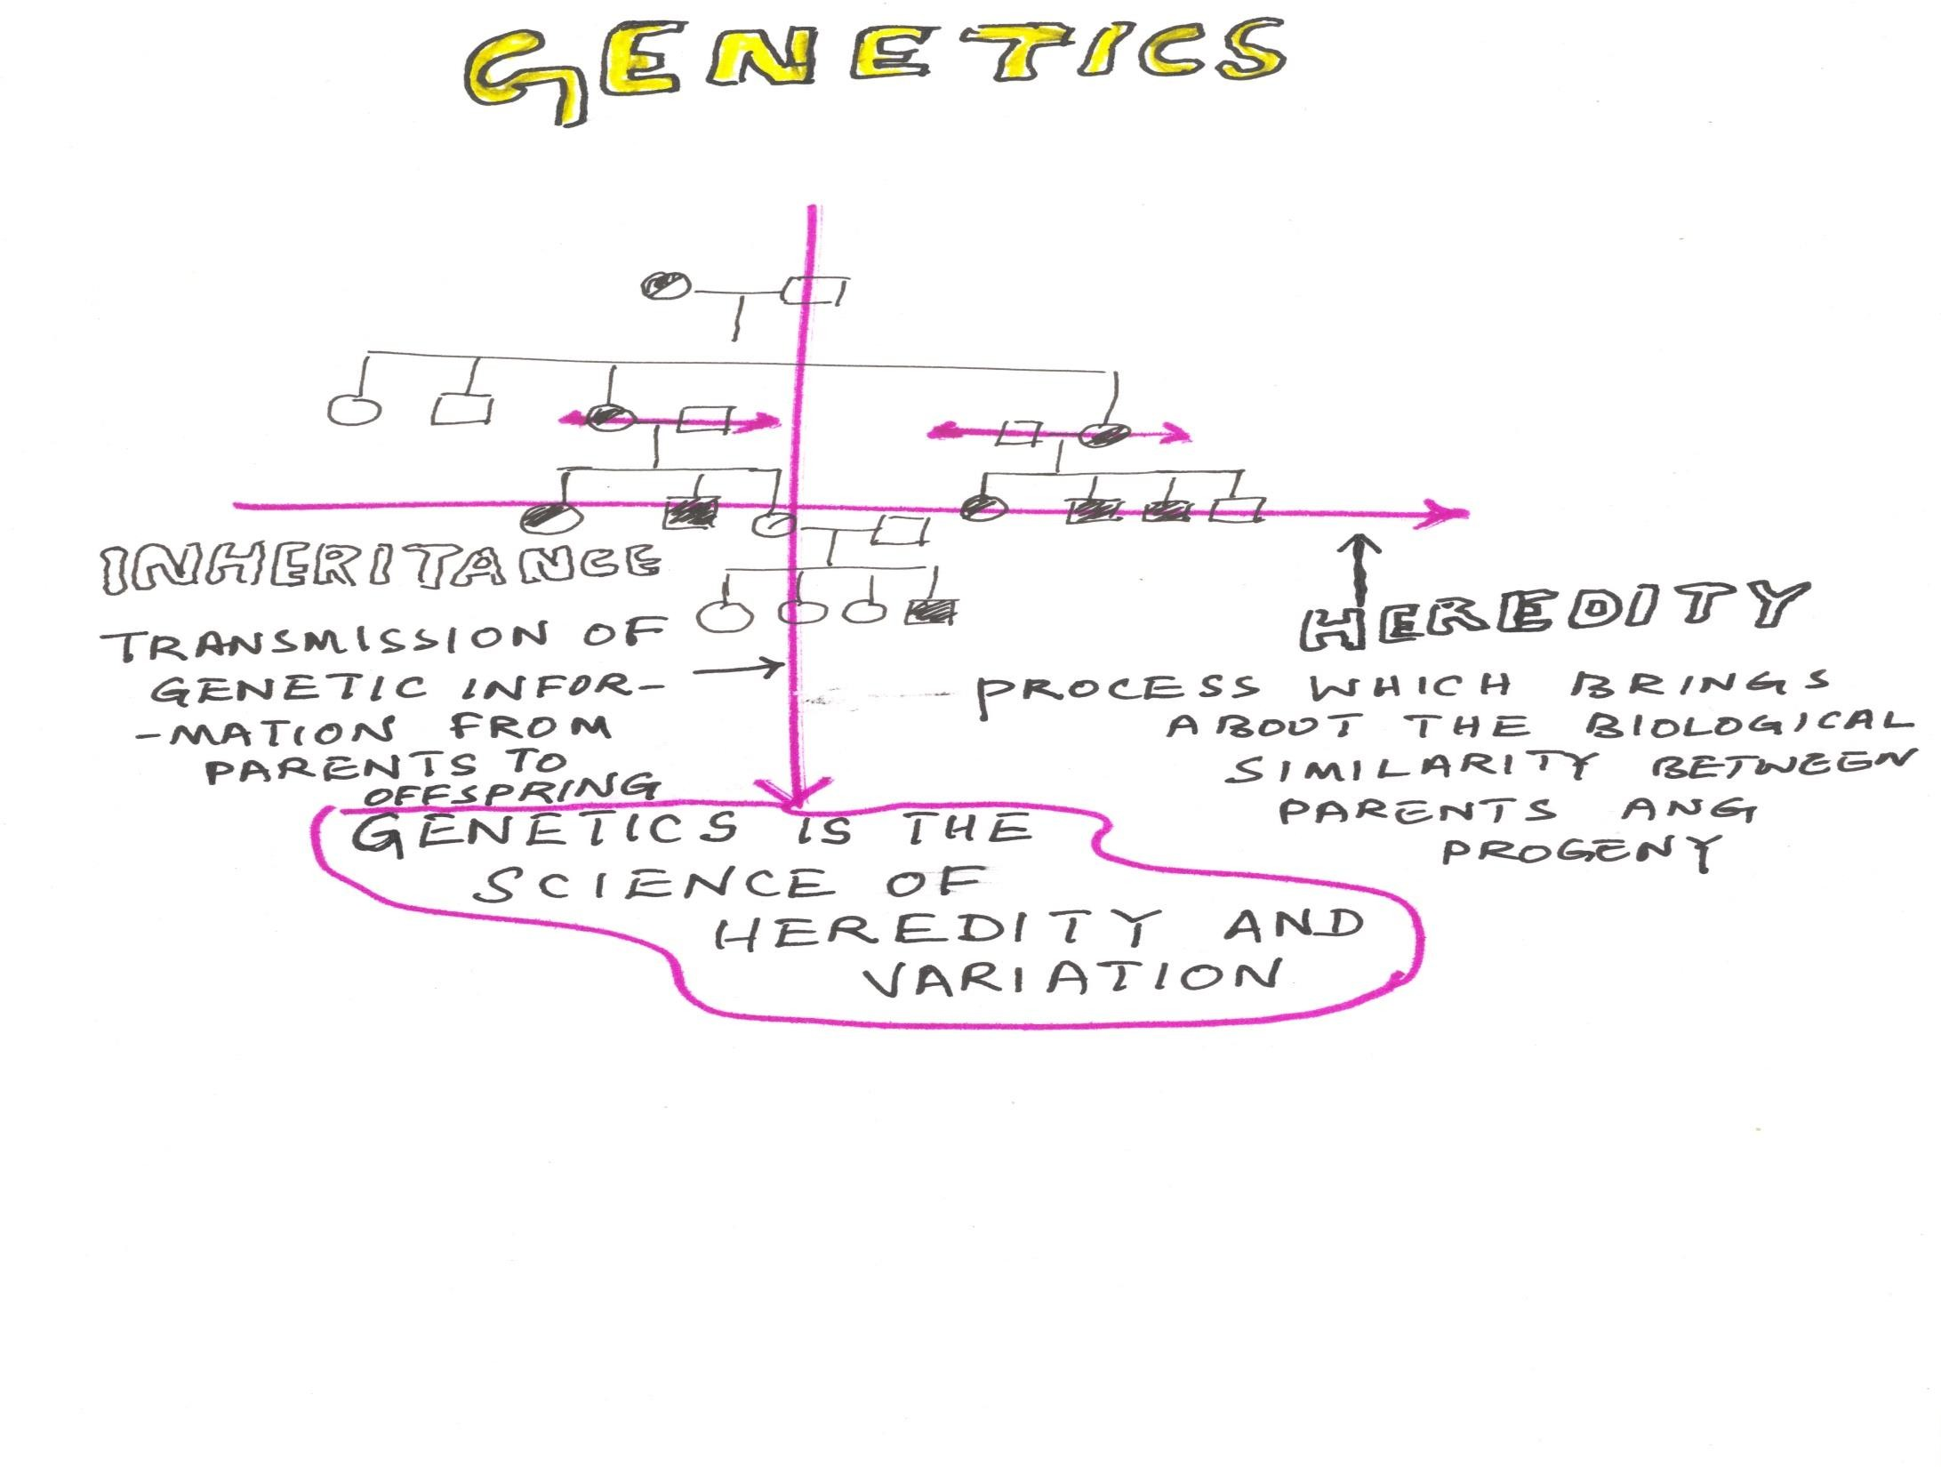
Genetics derived from Greek root-
gen = to become or
to grow into
The science that deals with the structure, organization, transmission and function of genes and the origin of variation in them

Slide 6
Cytology
Cell science – cell structure and function of cell organelles
with special emphasis on nucleus
how the chromosomes, the carrier of genes
behave in the somatic and reproductive cells of an organism
Cytogenetics
Expression of genetic behaviour at cellular level
» study of chromosomes
» Its behaviour in replication,
» reproduction
» organ development
» evolution of species
Cytogenetics is study of chromosomes in relation to genetics.
Dr.DD

Slide 7
Chief Events in Cytology
Year | Scientist | Discovery/ Event
1665 | Robert Hooke | discovered Cell
1831 | Robert brown | presence of nucleus
1838 | Schleiden and Schwann | Cell theory
1861 | Schultzee | Protoplasm theory
1870 | Fredrick Meischer | Isolated Nucleoprotein
1879 | Flemming | described chromatin in nucleus
1882 | Flemming | described cell division (Mitosis)
1888 | Waldeyer | Described chromosomes
1902 | Mc Clung | Sex Chromosomes
1903 | Sutton | Chromosome theory
1905 | Farmer and Moore | Coined the term Meiosis
1913 | Sturtvent | Built first chromosome map
1937 | Blakeslee | Induced polyploidy with Colchicine
Dr.DD

Slide 8
Early work on Genetics
Robert Hook (1665)
He described the cell as empty vessel.
He introduced term cell.
Cameraious:
He proved pollen is important for fertilizations. He is the first man to produce first artificial hybrid plant.
Koelreuter
He showed that F1 might resemble either male (or) female parents (or) combination of both.
Hereditary contribution of the two parents to their offspring was equal.

Slide 9
Knight
He obtained the dominant forms in F1 and segregation of various characters in F2.
Gaertner
F1 are uniform and their F2 produced considerable variation.
Naudin
Hybrids races and species of plants are often luxurient than either of the parents.
Robert Brown
He described the cell nucleus in the flowering plants.
He observed random thermal motion of small particles known as Brownian movement.

Slide 10
Schleiden and Schwann:
1.They discovered the formation of nucleus in the cell and formulated cell theory, which says the cell is the smallest building element of a multicellar organism.
2. each cell has a specific work to complete.
3. the cell can only produced from another division.
Strasberger:
He described fertilization in Angiosperms.
by cell

Slide 11
Van Beneden - Meiosis:
He showed number of chromosomes in the gametes, is half of the number of body cells.
In fertilization the chromosome contribution of eggs and sperms to the zygote are numerically equal.
Flemming - Mitosis:
He proposed mitosis in cell.
He showed the chromosome splitted during nuclear division and the formation of daughter nuclei.
he also applied the name chromatin which is to the stainable position of the nucleus.

Slide 12
History of Genetics
Gregor John Mendel
An Austrian botanist who laid foundation for the science of genetics.
Born in the year 1822 near Brunn in Austria
He worked with Pisum sativum - Garden pea
Presented a paper in 1865 – “Experiments in Plant Hybridization”
before the Natural History Society of Brunn
Mendel’s Paper was published in 1866
Formulated two important laws of inheritance in 1866
Law of segregation
Law of independent assortment
Died in the year 1884
Importance of his work was realized only in 1900
For this pioneer work he was called as the "Father of Genetics".

Slide 13
Rediscovery of Mendels work in 1900 by Correns, Hugo devries, Tschermak
Carl Erich Correns
A german botanist who rediscovered Mendel's work in 1900
He conducted research with garden pea and came to the same conclusion as drawn by Mendel in 1865.
He worked with Mirabilis jalapa (4'O' clock plant) and established the first conclusive example for Extrachromosomal inheritance
Hugo devries
Rediscovered the mendel's law of inheritance independentantly but
simultaneously with Correns and Tschermak in 1900,
He coined the term Mutation - sudden heritable changes in the characters
Tschermak
One of the co discoverers of Mendel's classic papers on garden pea
He applied mendel's law of heredity in barley, wheat rye hybrids and oat hybrids for the development of new plants

Slide 14
William Bateson Coined the term Genetics in 1905
William Bateson and Punnett
Discovered the phenomena of linkage (closely located genes on the same chromosome)
sex determination, linkage and first case of autosomal linkage
They founded the Journal of Genetics Johannsen
Developed the concept of Pureline
Given the name ‘gene’
Coined the name “phenotype” and “genotype” in 1903
Supported the mutation theory of Hugo de vries
Also recognized the importance of environment in the expression of characters.
Nilsson Ehle (1908) published his multiple-factor hypothesis.

Slide 15
Morgan, T.H.
Established the chromosome theory of heredity in 1910.
He showed that genes are linked in a series on chromosomes and are responsible for observable genetic traits.
Received Nobel Prize for Physiology and Medicine in 1933.
Discovered hereditary transmission mechanisms and sex linkage in Drosophila.
Bridges, C.B.
Established the chromosomal basis of heredity and sex.
Constructed detailed gene map of the giant chromosomes found in the salivary gland cells of fruit fly larva.
Discovered genic balance theory of sex determination and gene duplication in Drosophila.
Muller, H.J.
X- rays speed up the natural process of mutation.
For experimental induction of mutation he was awarded Nobel Prize.

Slide 16
Painter (1939) discovered giant chromosomes in the salivary gland cell of Drosophila provided an additional avenue of approach to an understanding of the chromosome and its usefulness in cytogenetic research .
The discovery by Muller (1927) that X-rays could be used to induce mutations opened a new line of work.
The discovery by Blakeslee (1921) that colchicine could be used to double the number of chromosomes opened another new line of work.

Slide 17
Beadle and Tatum
Proposed the concept of one gene one enzyme
hypothesis for which they received Nobel prize in 1958
Avery, Mac Leod and Mc carty
Discovered the phenomenon of transformation
They (Avery, Mac Leod and Mc carty) reported that the substance which caused the transformation was DNA and demonstrated the DNA was the genetic material

Slide 18
Watson and Crick (1953) and Wilkinson
The X ray diffraction studies of DNA by Wilkinson resulted in the Discovery of the molecular structure of DNA, in 1953 by Watson and Crick
Watson and Crick - proposed the double helix model of DNA
The three scientists received Nobel prize in 1962
Barbara Mc Clintock
Discovered transposons/ jumping genes in Maize in 1950
Genes that are capable of changing their position on a chromosome and from one chromosome to another
Awarded Nobel Prize in 1983

Slide 19
Benzer
Detail structure of viral genes and coined the term cistron to denote functional sub unit of genes
Gave sub divisions of genes viz., Cistron, Recon and Muton. These are the units of function, recombination and mutation within a gene.
Meselson and Stahl
Experimentally confirmed the semiconservative replication of DNA
F.H.C. Crick
Proposed the Central Dogma of Molecular Biology in 1958
Gave evidence for the triplet nature of genetic code in 1961
Nirenberg - Responsible for deciphering the genetic code- 1961 Jacob and Monad
Explained gene regulation in cell metabolism by directing the biosynthesis of enzymes - Operon concept in 1962
Awarded Nobel prize in 1965

Slide 20
Khorana
Discovered how the genetic components of the cell nucleus control the synthesis of protein
Awarded Nobel prize in 1968 with Nirenberg and Holley
He prepared the first artificial copy of a yeast gene in 1970
Stanley Cohen and Herberd Boyer
Genetic Engineering in 1973
A.M. Maxam and W.Frederick Gilbert; F. Sanger and Coulson
Sequencing of DNA in 1977
Craig Venter (2001) – human Genome Project – Complete sequencing of human genome
Goff et al and Yu et al (2002) – Rice Genome Sequencing

Slide 21
What are the other genome sequence projects completed still now ??
PLANTS
ANIMALS
MICRO ORGANISMS
TREES
HIGHER ORGANISMS

